Slide 1

Tableau:
Medical Device Analytics
Anthony Graffigna, Melat Demeke, Abhishek Shrestha

Slide 2



Key Concerns
The Medical Device industry has primarily implemented Data Analytics and Tableau in the Sales and Supply Chain aspects of their businesses

Slide 3
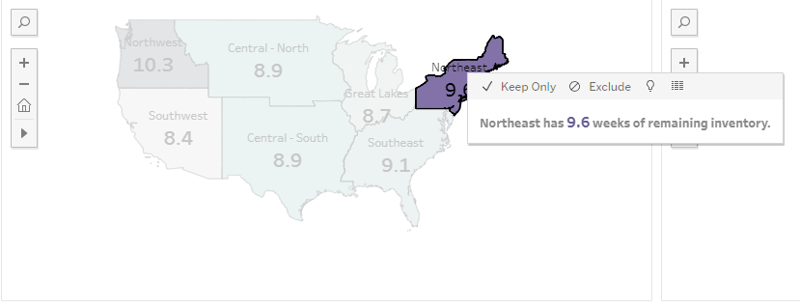
Inventory Management
Suppliers use Tableau to track and visualize average remaining inventory by Time, broken down by region

Slide 4
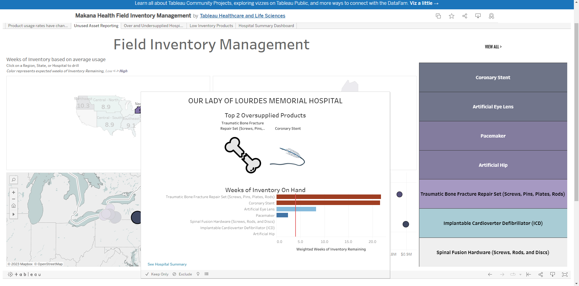
Inventory Management
They also create breakdowns on more granular levels, such as per-hospital, to identify over and undersupplied products
These dashboards and metrics can help inform production timelines and priorities

Slide 5
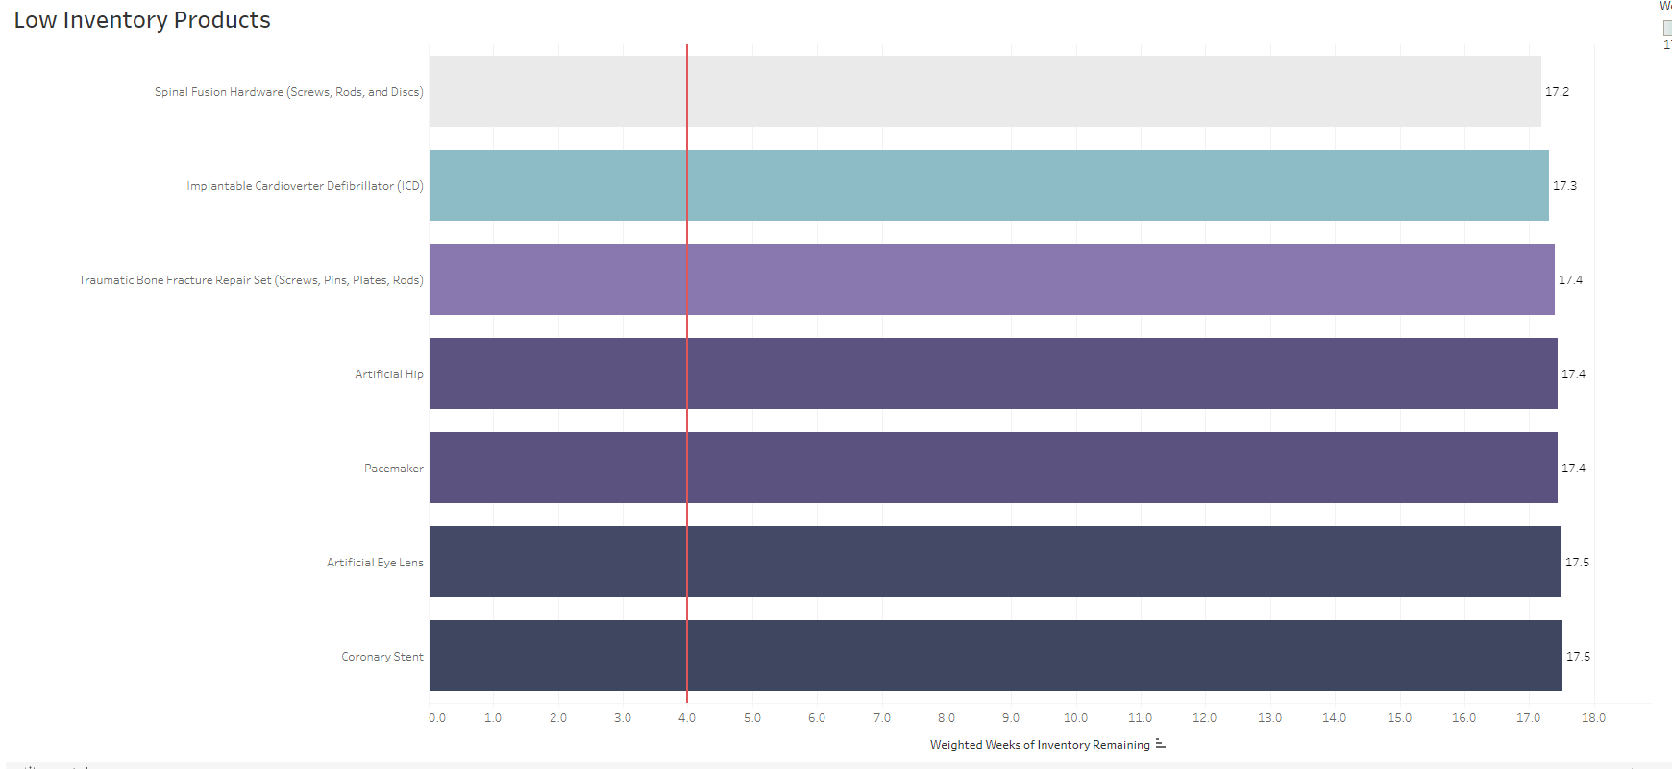
Inventory Management
They can additionally zoom out to identify low-inventory products across the entire industry or a particular region, further informing production timelines

Slide 6
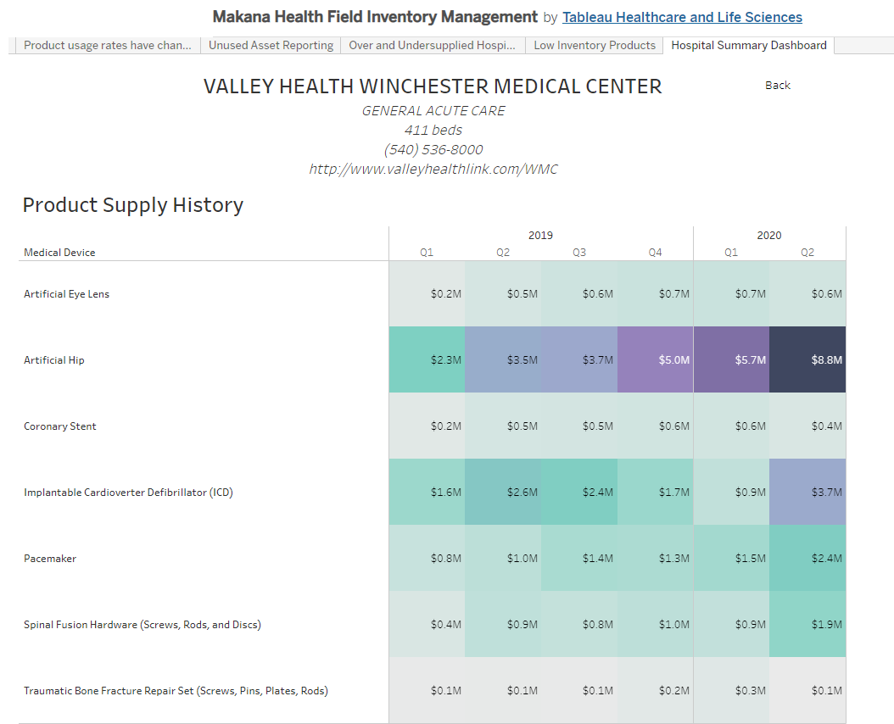
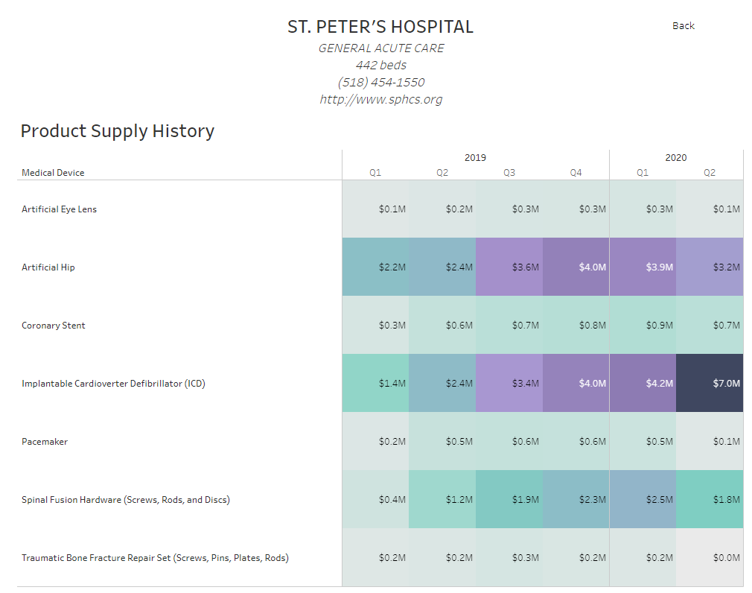
Inventory Management
Finally, they can use this usage data, combined with sales and profit data, to track financial performance with individual clients, broken down by individual products

Slide 7
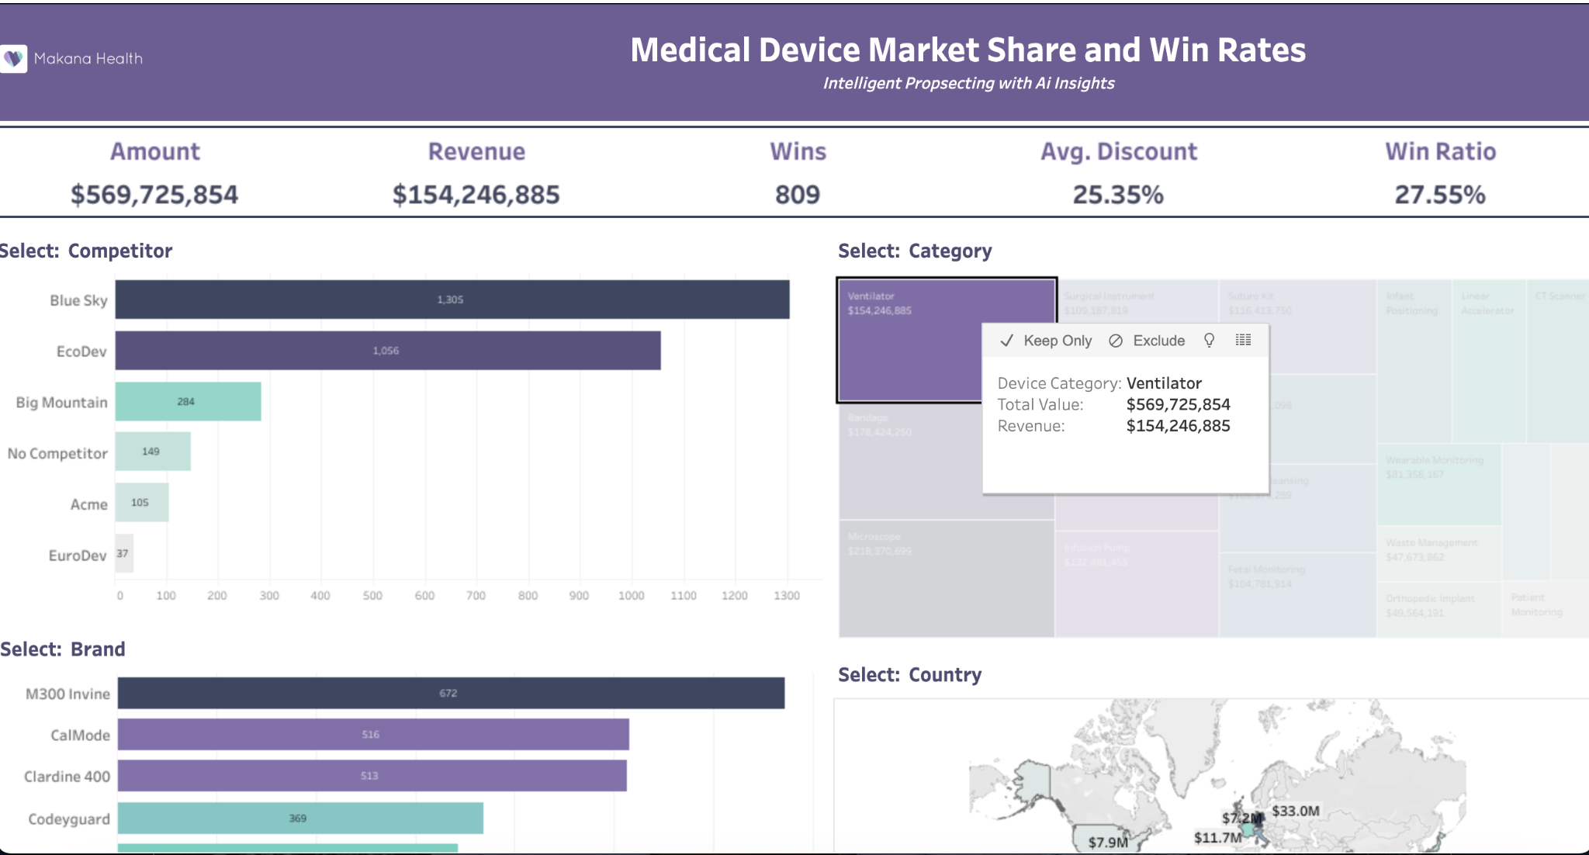
KPI’S
Sales Revenue
Market Share
Win Ratio

Slide 8

NovoEnzymes
Cut reporting time by 90%!
Before Tableau: Excel Spreadsheets
Improves business agility
Cuts down on time wasted
Identifies lost opportunities and re-engages customers resulting in potential revenue

Slide 9

CooperVision
Used to spend 90% of time in report creation
Now spends 30% of time in report creation
Use Tableau to identify growth opportunities 70% of time

Slide 10


Call to Action
Inspiration to Action: “Boston Scientific closes the Gap between business and IT”
Integrate with Data Driven Culture: “Cardinal Health, digital transformation through data literacy”
Exploring Possibilities: “ CooperVision drives regional growth by identifying opportunities from data”

Slide 11
Data Requirements for Insights
Sales Data
Supply Chain Data
Customer Feedback
Data Collection Strategies:
Surveys and Feedbacks
Real time Data Collection
Integration with Existing Systems
Collaborate with Departments

Slide 12


Thanks!

